Slide 1
Jak wytrenować smoka?
Uczenie maszynowe w grach
Mateusz Bąk

Slide 2
Uczenie maszynowe
Machine learning (ML) is the scientific study of algorithms and statistical models that computer systems use to effectively perform a specific task without using explicit instructions, relying on patterns and inference instead. It is seen as a subset of artificial intelligence. Machine learning algorithms build a mathematical model of sample data, known as "training data", in order to make predictions or decisions without being explicitly programmed to perform the task.
'Machine learning', Wikipedia, The Free Encyclopedia,
https://en.wikipedia.org/w/index.php?title=Machine_learning&oldid=898794298
(dostęp 27.05.2019)

Slide 3
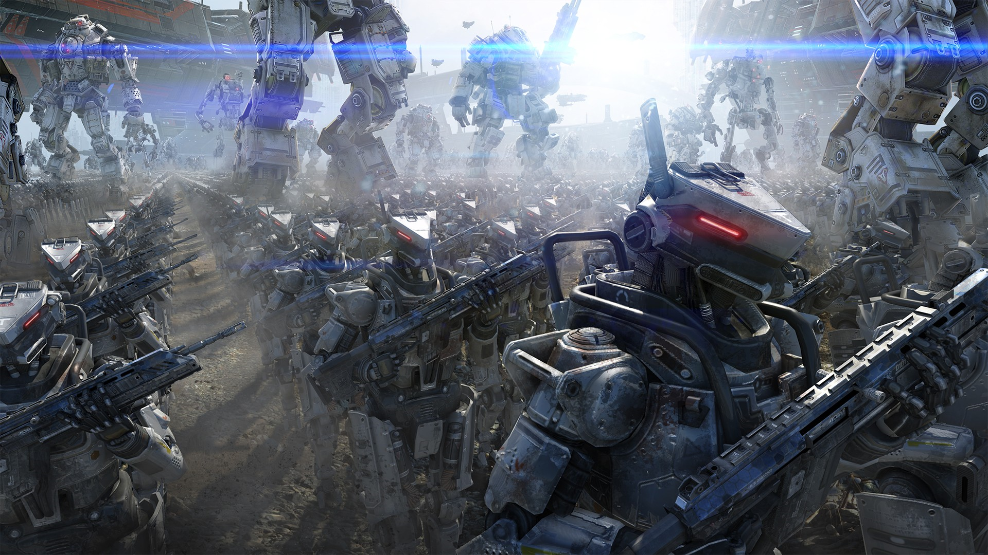
Co widzi gracz?

Slide 4
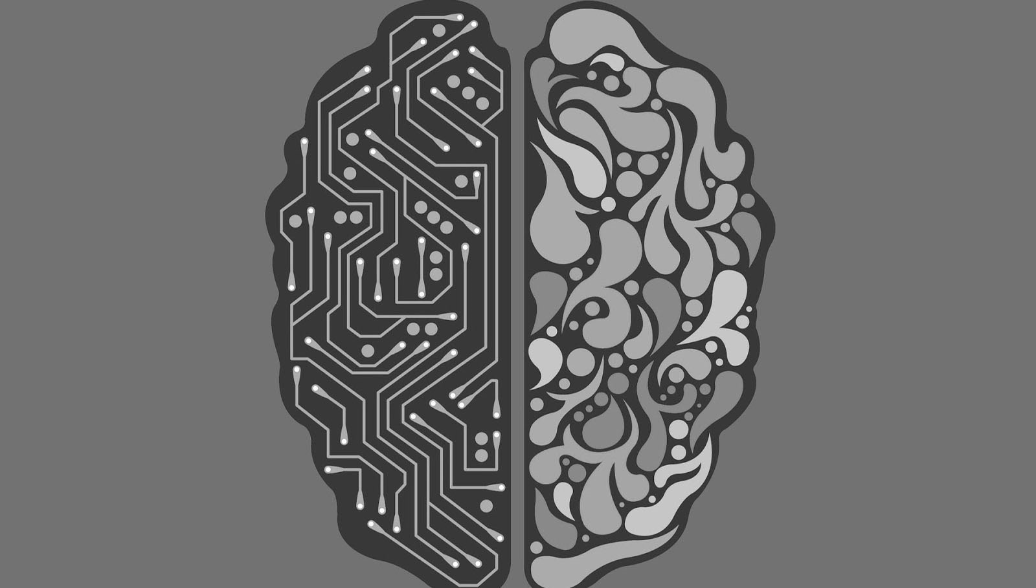
Projektowanie wspomagane SI

Slide 5

Proceduralna generacja treści
DOOM Level Generation using Generative Adversarial Networks
Edoardo Giacomello, Pier Luca Lanzi, Daniele Loiacono

Slide 6
Animacja
Phase-Functioned Neural Networks for Character Control
Daniel Holden, Taku Komura, Jun Saito

Slide 7
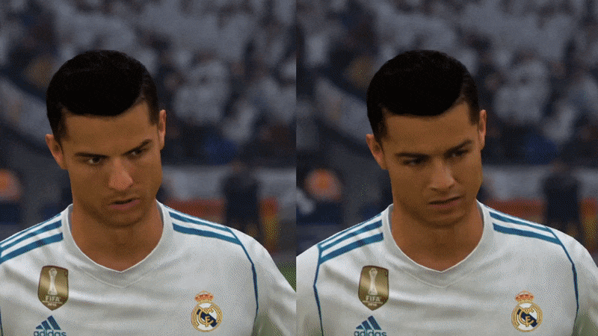
Grafika
https://towardsdatascience.com/using-deep-learning-to-improve-fifa-18-graphics-529ec44ea37e

Slide 8
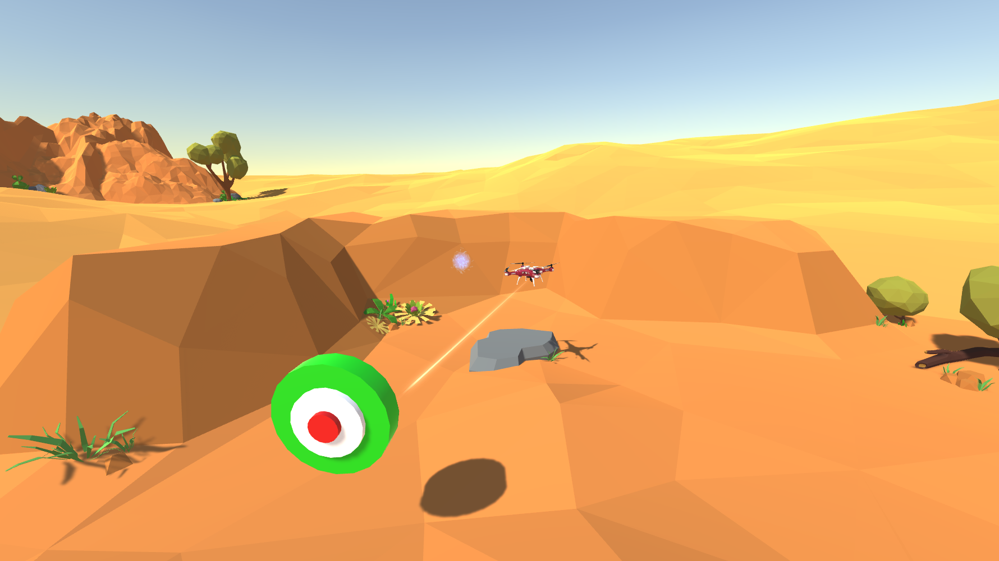
Środowisko treningowe

Slide 9
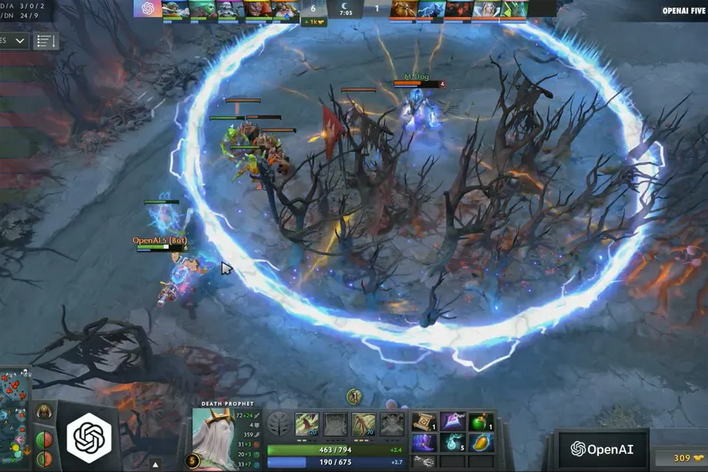
Testowanie kompetencji

Slide 10

Jak wytrenować smoka?

